Slide 1
Case Study: Regression data of a real estate company
Ironhack-Mid Bootcamp Project
Aravind Endluri
Xabi Laibarra
Nikos Karras
Teacher: Felipe Rocha
Teacher Assistant: Cristian Castro Blua

Slide 2
Targets of the Mid Bootcamp Project
Data analysis of the real estate company’s data
Explore the data
Build a machine learning model to predict the selling prices of houses based on features provided in the dataset
Compare the accuracies of different models and find the model that best fits our data Explore the characteristics of the houses using some business intelligence tools
Understanding which factors are responsible for higher property value - $650K and above
Visualize the explored data

Slide 3
Process of exploring the data
Looking for the factors that are responsible for higher property value
finding the model that best fits our data
the model that best fits our data is: from the whole dataset we dropped the rows of the extreme outliers (outliers from the outliers) and by using Min-max scaler for the numerical features and One Hot/Label Encoding for the categorical feature and applying the linear regression we get a very good R2 score with representative subsets
importing libraries-reading the data
general info about the dataframe
check and deal with NaN values
EDA (Exploratory Data Analysis)
dealing with specific columns (converting column zipcode to categorical)
finding cheap opportunities
seperating numerical-categorical features and continuous-discrete numeric data
correlations for the numerical features
plotting scatterplots with our target column and high correlated features
build different models(including linear regression and KNN) and compare their accuracies
checking outliers and dealing with them

Slide 4
general info about the dataframe to understand better the data-EDA (Exploratory Data Analysis)
Dataframe’s shape : (21597, 21)
check and deal with NaN values: there are no NaN values in the columns
finding the quantity of each observation in every column-feature
describe the dataframe
distribution plots of the variables
dealing with useless columns: convert the variable-column 'id' to an index, drop the columns 'lat' and 'long‘-
converting column zipcode to categorical: the column's rows of zipcode are just a sequence of numbers, so we convert it to categorical

Slide 5
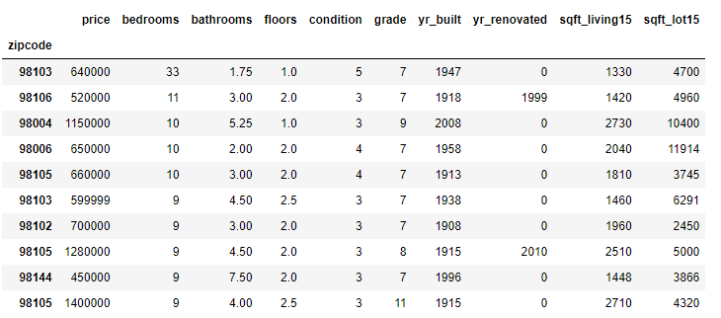
playing with the data-finding cheap opportunities
top10_biggest_houses
We have 3/10 apartments in the zipcode 98105
We also checked some opportunities of houses with good characteristics and low prices by filtering
good_houses_low_prices: price< 500000, yr_built> 1980, condition> 2, grade> 9
most of the opportunities-apartments are with 3-4 bedrooms, 2 bathrooms, 2 floors, condition 3, grade 10
and most of them are in the area with zipcode 98023 specifically
98023: 11 observations, 98030-98042-98003: 3 observations, 98001: 2 observations, 98058-98199-98031-98092-98045-98038-98166-98119: 1 observation

Slide 6
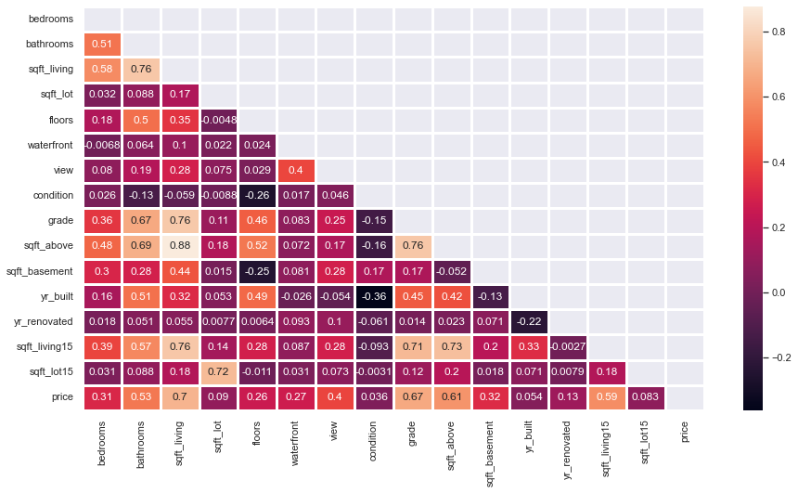
separating numerical-categorical features and continuous-discrete numeric data-correlations between the numerical features
column price is our target
checking the correlation for each numerical column with the column 'price‘ in descending order
price=1.000000, sqft_living=0.701917, Grade=0.667951, sqft_above=0.605368, sqft_living15=0.585241, Bathrooms=0.525906, View=0.397370, sqft_basement=0.323799, Bedrooms=0.308787, Waterfront=0.266398, Floors=0.256804, yr_renovated=0.126424, sqft_lot=0.089876, sqft_lot15=0.082845, yr_built=0.053953, Condition=0.036056

Slide 7
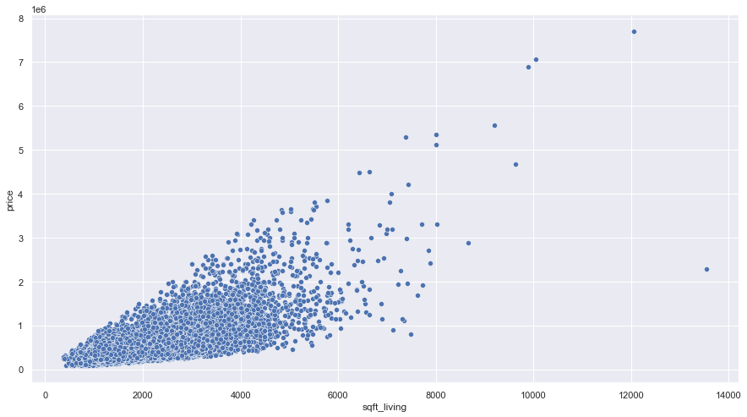
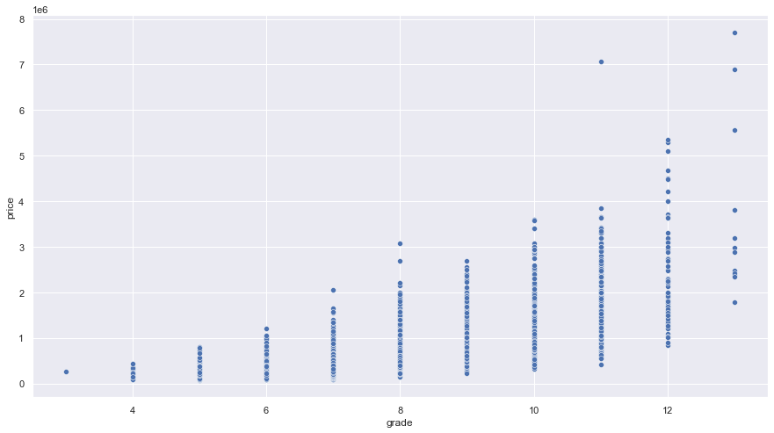
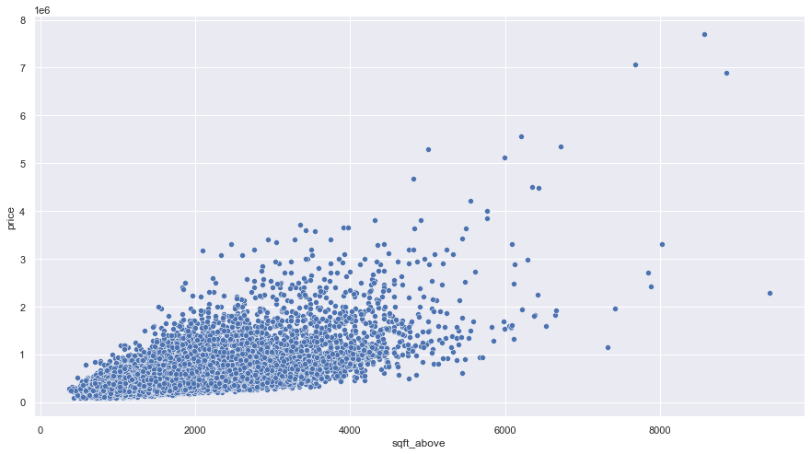
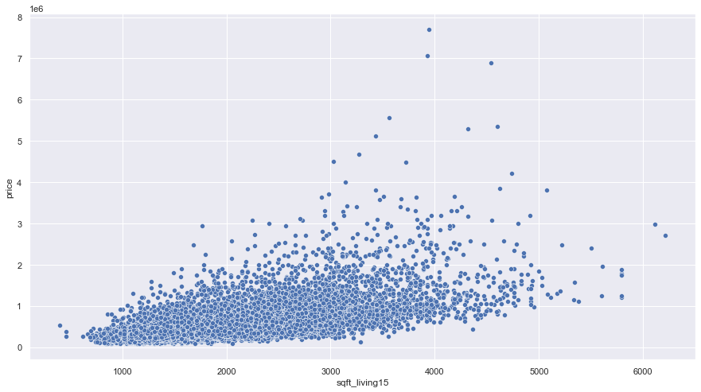
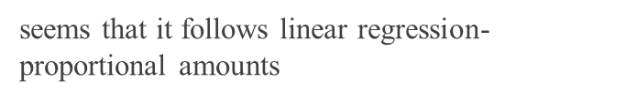
scatterplots with our target column and the high correlated features
seems that it follows linear regression
proportional amounts-close to exponential distribution
seems that it follows linear regression-proportional amounts

Slide 8
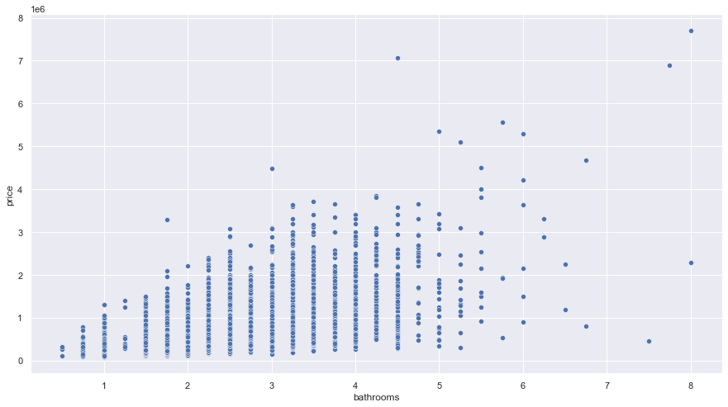
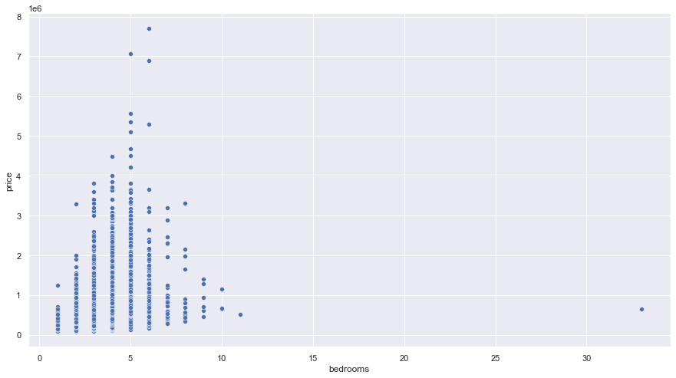
scatterplots with our target column and the high correlated features
most expensive houses tend to have more bathrooms and vice versa
most expensive houses tend to have 3-7 bedrooms and vice versa

Slide 9
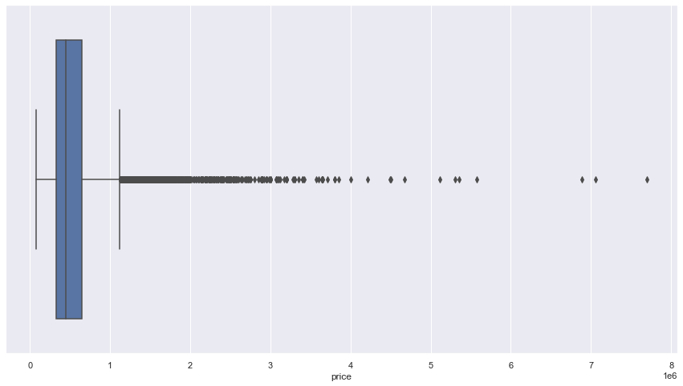
Different models
1st model) Using the whole data (including outliers).
Price range: whole price range.
2nd model) Using the data of the houses that are most expensive than 650K$
Price range: 650K $ < house price < 2M$
3rd model) Using the whole data (without extreme outliers).
Price range: houses cheaper than 2M$
boxplot of the target variable

Slide 10
Build a Model
We follow the following process
X-y split, train-test split
Encoding the categorical feature-zipcode
Using Min-max scaler for the X trained numerical data
Concatenating the dataframes of the normalized trained numerical and encoded (trained) categorical-zipcode
Apply linear regression to the trained data. Fit the model in Supervised learning. Assume a linear relationship between 𝑦 and 𝐱: 𝑦 = 𝛽₀ + 𝛽₁𝑥₁ + ⋯ + 𝛽ᵣ𝑥ᵣ + 𝜀
We make the same process for the test subset
In the first model we also use KNN-K Nearest Neighbors and StandardScaler but we found less r2 scores in both cases

Slide 11
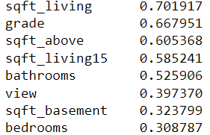
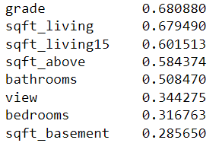
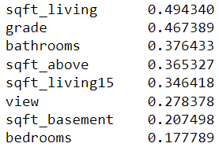
Correlations- high correlated features with the target
A) Using the whole data (including outliers).
B) Using the whole data (without outliers)
C) Using the data of the houses that are most expensive than 650K$ (after removing the outliers).

Slide 12
metrics
Metrics
 | MinMaxScaler 1st model - Using the whole data (including outliers) | StandardScaler 1st model - Using the whole data (including outliers) | KNN-K Nearest Neighbors 1st model (k=3) - Using the whole data (including outliers) | MinMaxScaler 2st model - Using the data of the houses that are more expensive than 650K$ (after removing the extreme outliers) | MinMaxScaler 3rd model -Using the whole data (without outliers), observations smaller than 2 M$
r2_score | 0.79439 | 0.79438 | 0.75676 | 0.68556 | 0.83040
MSE (Mean Squared Error) | 163626.63521 | 163628.59991 |  | 157802.42921 | 119897.897602
RMSE (Root Mean Squared Error) | 404.50789 | 26774318709.50885 |  | 397.24353 | 346.26275
MAE (Mean absolute error) | 97236.553720 | 97226.23841 |  | 117194.277 | 81253.933215

Slide 13
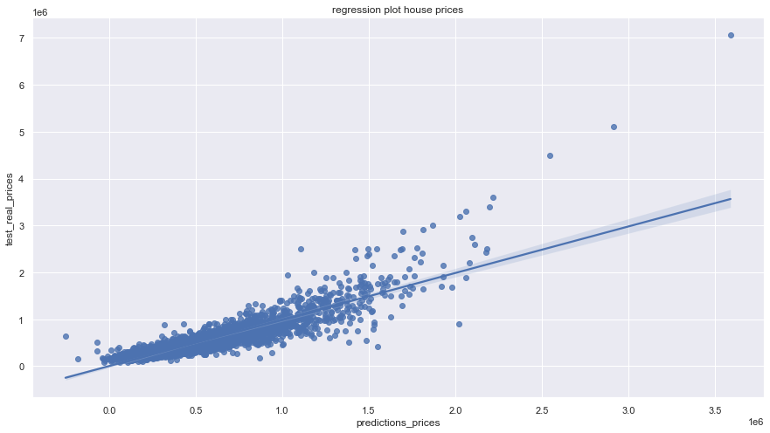
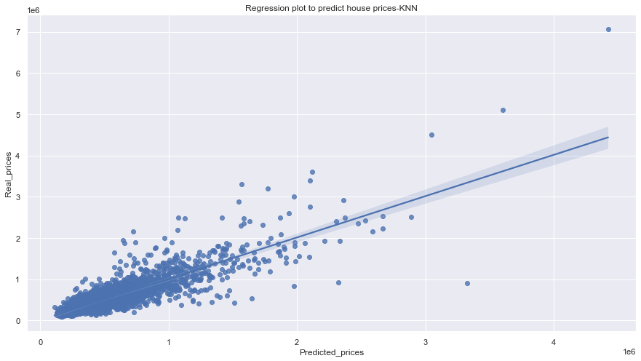
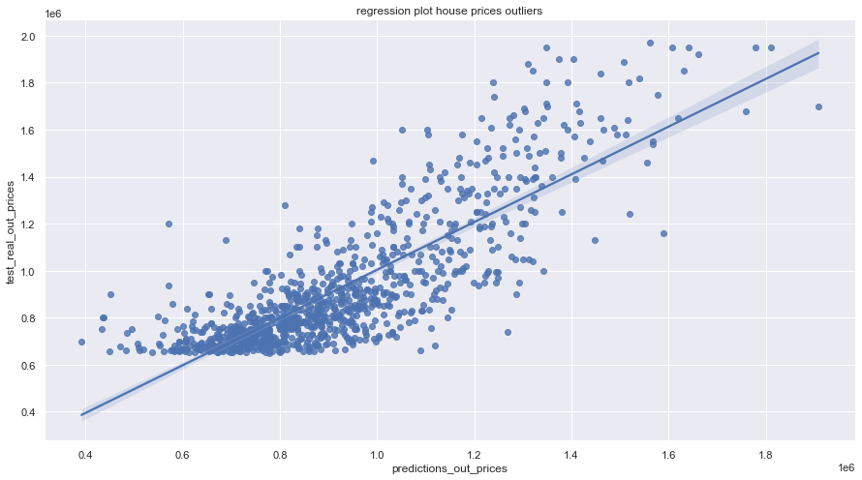
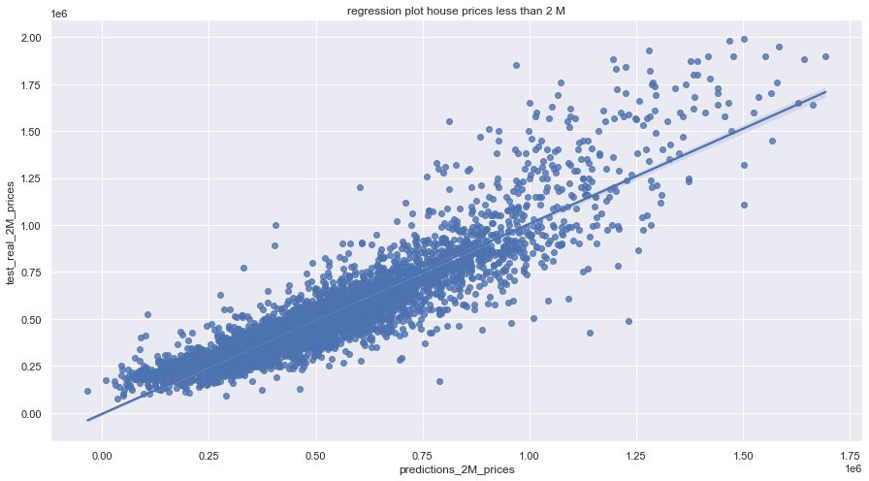
Regression plots for some cases
regression plot between predictions_prices and test_real_prices, 1st model, using MinMaxScaler
regression plot between predictions_prices and test_real_prices, 1st model, using using KNN-K Nearest Neighbors
regression plot between predictions_out and test_real_out_prices, 2nd model, using MinMaxScaler
regression plot between predictions_2M and test_real_2M_prices, 3rd model, using MinMaxScaler

Slide 14
Conclusions-Limitations of the model
Difficult to predict the prices of the houses, which are more expensive than 650K$
A) Very wide price range (approximately from 650 K-8 M) – there are extreme outliers
B) Very few houses in that price range-no representative sample
Reasons:
A) Better results after dropping outliers (smaller price range)
B) Better results using all the houses cheaper than 2M$ (large amount of houses)
the feature bathrooms affects more the outliers according to the correlations matrix
(we saw the trend in the plots of Tableau)

Slide 15
Food for thoughts
We could also try more technics in our models, for instance:
Dropping some features with low correlation to target column
Dropping some features, which cause multicollinearity
Scaling with different methods (for example box cox transformation)
Using a, b tests
Any ideas?

Slide 16
Thank you for watching our presentation Gracias - Ευχαριστούμε(Efcharistoúme) -धन्यवाद(dhanyavaad)

